Slide 1
INTERVIEWING TIPS
By Kay Kunda – Career Coach

Slide 2
PURPOSE OF THE INTERVIEW
The interview is a conversation in which you and an employer exchange information. Your objective is to get an offer of a job, and the employer's objective is to find out the following:
What you have to offer (your skills, abilities, basic knowledge).
Who you are (your personality, character, interests).
Why you should be hired (you have what they are seeking). The interviewer will try to determine whether you will be an asset to the organization.

Slide 3
Your Goal is……
To present yourself as the best candidate for the position and also to learn more about the position and the organization to determine whether both are well suited for you and your career goals.
Note- the interview is a two-way discussion rather than an interrogation, as it is often perceived to be.

Slide 4
PREPARING FOR THE INTERVIEW
You need to get your goals in focus. You need to know what you want, where you want to be, who can employ you and, most importantly, why you will be good at the job you seek. If you are undecided or unsure about the jobs that best match your skills, interests, and background, take time now to assess yourself and explore various career fields. It is very difficult and can be frustrating to conduct a job search if you are unsure about your career options.

Slide 5
Know Yourself
Most interviews include questions regarding your qualifications, education, community activities, prior work experience, personal characteristics, skills, and career interests. To prepare for answering questions about yourself, think about the following questions:
Which personality characteristics and skills do I want to talk about?
What job experiences are most relevant to this position?
What did I gain from my college education?
Focus on those experiences that best sell you for the position for which you are interviewing.
Identify your three main strengths. Be able to cite specific examples and apply these strengths directly to the requirements of the position you are seeking. You should also be prepared to state the reasons why you should be hired, what you have to offer the employer, and your interests in the position.

Slide 6
Research the Position
Analyze the job description and how your background, skills, and experience apply to the position.
Evaluate your interest in this career field and be able to verbalize it. If the job description is limited, research similar jobs in similar companies and look up information on the job title in various career information resources, such as the O*Net.

Slide 7
Research the Employer and Industry It is important to learn as much as you can about the employer before you interview. By adequately researching the organization, you will have a much better chance of creating a positive impression. The following questions can help guide your research:
How well is the organization doing? (growth patterns)
Who are the organization's clientele or customers and major competitors?
What are the organization's entry-level positions and career paths?
What type of training does the organization offer its employees?
What are the organization's philosophy and goals?
What are the size and structure of the organization?
What are the organization's products and services?
What is the organization known for?
What are the geographical locations of its plants, stores, or sales outlets?
Notes:
To obtain information about the employer, read company annual reports, recruiting brochures, promotional materials, job descriptions, trade journals, Wall Street Journal, Fortune, Business Week, and other business publications. Faculty, alumni, friends, and present employees can also be helpful sources of information. Get Reference form people that work or have worked for the company.

Slide 8
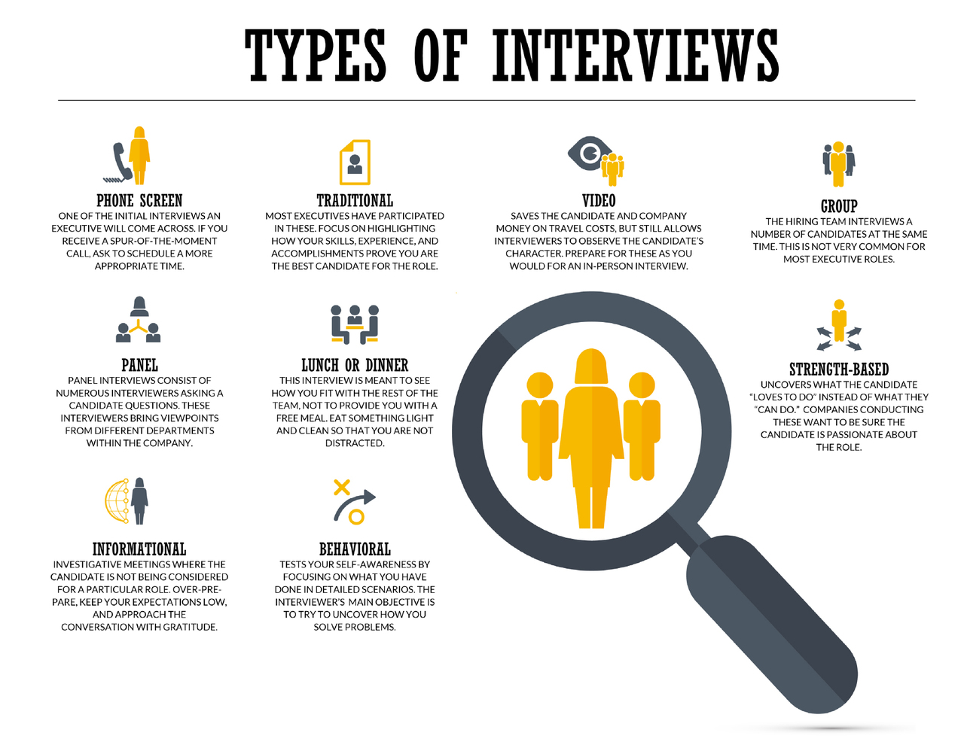

Slide 9
How to Prepare for a Video Interview
Test Your Technology.
Keep Your Virtual Identity Professional.
Dress for Success.
Create a Set.
Monitor Your Body Language.
Rid Yourself of Distractions.
Practice Answers to Common Interview Questions.
Don't Forget to Follow Up.
HireVue Video Interview: 5 MISTAKES You Need to AVOID
https://www.youtube.com/watch?v=J2VnJOw5Cd0
Notes:
HireVue Video Interview: 5 MISTAKES You Need to AVOID
Be mindful for the virtual background you are using- DON’T USE SPACE BACKGROUND!!

Slide 10
What is a behavior-based interview?
Today, more than ever, every hiring decision is critical. Behavioral interviewing is designed to minimize personal impressions that can affect the hiring decision. By focusing on the applicant's actions and behaviors, rather than subjective impressions that can sometimes be misleading, interviewers can make more accurate hiring decisions.
Behavior-based interviewing focuses on experiences, behaviors, knowledge, skills, and abilities that are job related. It is based on the belief that past behavior and performance predicts future behavior and performance. You may use work experience, activities, hobbies, volunteer work, school projects, family life as examples of your past behavior.
Current employment literature indicates that there is a strong trend towards this type of interviewing. In addition to questions found in many current resources, you should also consider the following in your interview preparations.

Slide 11
What do employers evaluate in a behavioral interview?
Employers are looking for three types of skills: content skills, functional (also called transferable skills), and adaptive (also called self-management skills).
Content Skills - Knowledge that is work-specific (e.g., computer programming, accounting, welding, etc.), expressed as nouns.
Functional or Transferable Skills - Used with people, information, or things (e.g.. organizing, managing, developing, communicating, etc.), expressed as verbs.
Adaptive or Self-Management Skills - Personal characteristics (e.g., dependable, teamplayer, self-directed, punctual, etc.) expressed as adjectives.

Slide 12
How can I best answer behavior-based questions?
The PAR technique is a way to build strong answers to behavioral interviewing questions. The idea is to provide a specific example or “story” of how you have performed well on the job in the past. This can help the employer see how you might do a good job for them. PAR stands for Problem – Action – Result.
A complete answer to a behavior-based question must explain the task or problem for which you were responsible, the specific actions you took, and the results of your actions. Your answer must contain all of these components to be a PAR answer. Tell the interviewer a "story" (with a beginning, middle, and an end) about how you used a practical skill.

Slide 13
Problem (P) - Advertising revenue was falling off for the Daily News, and large numbers of long-term advertisers were not renewing contracts.
Action (A) - I designed a new promotional packet to go with the rate sheet and compared the benefits of DN circulation with other ad media in the area. I also set up a special training session for the account executives with a College of Business professor who discussed competitive selling strategies.
Results (R) - We signed contracts with fifteen former advertisers for daily ads, and five for special supplements. We increased our new advertisers by twenty percent (quantities are always good) over the same period last year.

Slide 14
What is the star method in interviewing?
The STAR method is a structured manner of responding to a behavioral-based interview question by discussing the specific situation, task, action, and result of the situation you are describing. Situation: Describe the situation that you were in or the task that you needed to accomplish.

Slide 16
KNOCKOUT FACTORS Some reasons why applicants do not receive job offers or second interviews:
• Inability to express oneself clearly - poor voice, diction, or grammar • Poor personal appearance
• Not prepared for interview no research on the organization
• Overbearing overaggressive, conceited, "know-it-all“
• Uncertainty about future goals and career plans
• Lack of interest and enthusiasm - passive, indifferent
• Asks no or poor questions about the position
• Lack of confidence - nervousness, fails to look interviewer in the eye Poor scholastic record - just got by
• Unwillingness to start at the bottom - expects too much, too soon
• Speaking derogatorily about former employers, supervisors, or other people
• Lack of maturity, courtesy, and tact

Slide 17
Practice, Practice, Practice!!!
Many interview questions are predictable and can be anticipated prior to the interview.
Practice speaking out loud in front of a mirror, into a tape recorder, or with a friend.
You can also predict "job-specific" questions by analyzing the job description—duties, responsibilities, and skills of the position.
Do not memorize your responses, but instead outline the key points that you want to stress.

Slide 18
SOME FINAL COMMENTS….. Be yourself!
There is no special formula for excelling in a job interview. Your personality and background may appeal to some employers and not to others.
It is to your advantage to be yourself, rather than try to mold yourself to fit an image you think will appeal to an employer.
After all, you want to find a position and employer that is compatible with "who you are" and your career objectives.

